Slide 1

EE463 Hardware Project
2025-2026 Fall
DC Motor Drive
POWERpuff Boys
Mohammad Lotfi 2419364
Arda Yungucu 2517357
Hüseyin Umut Suna 2516938

Slide 2
Topology Selection
Single Phase Diode Rectifier + Buck Converter
Three Phase Diode Rectifier + Buck Converter

Slide 3
The Problem with the Single Phase Rectifier
Single-Phase rectification causes deep voltage ripples (100 Hz).
To maintain stable 180V output, a huge capacitor (>2000 mikroF) is required.
Also Lab inventory only provides max 470 mikroF (High Voltage) capacitors.

Slide 4
The Solution:
Selected: Three-Phase Rectifier.
3-Phase DC bus never drops to zero (V_min = 1.5* V_peak).
Result: The available 470 mikroF capacitor is perfectly sufficient for filtering, eliminating the need for unavailable components.

Slide 5
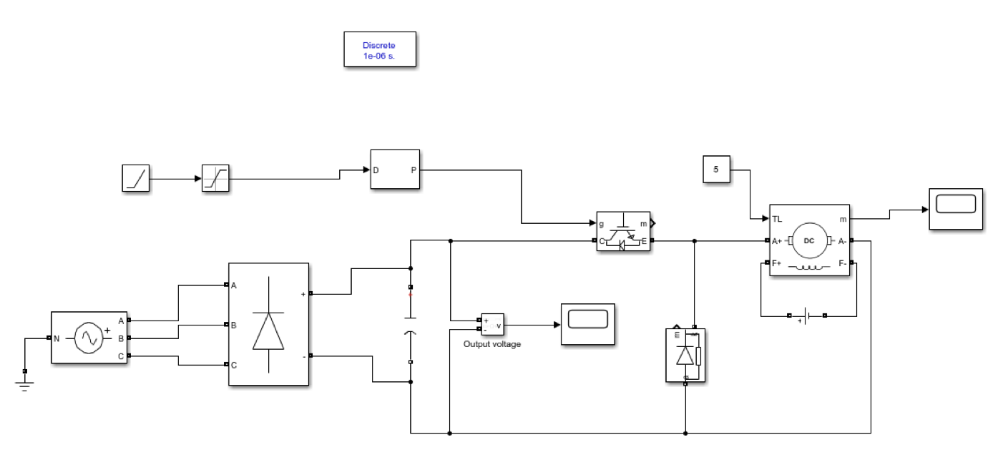
Our Design:

Slide 6
Component Selection Strategy
1. Input Stage:
Component: Industrial 3-Phase Bridge Module (35A / 1000V).
Source: External procurement.
Simplifies wiring and robustness compared to discrete diodes.
2. Power Stage (Available in Lab):
IGBT: IXGH24N60C4D1 (600V / 30A).
Diode: MUR1560G (Ultrafast, trr< 60ns).
3. Safety Upgrade:
Capacitor: 470 mikroF / 450 V (for 300V DC Bus safety margin).

Slide 7
Control Strategy (Analog Soft Start):
Controller: TL494 CN (Analog PWM Controller)
Utilizing the DTC (Dead-Time Control) pin.
An external Capacitor charges at startup >> Duty Cycle ramps linearly from 0% to Setpoint.
Objective: Analog Controller Bonus.
Controller: TL494 CN (Analog PWM Controller)
Controller: TL494 CN (Analog PWM Controller)

Slide 8
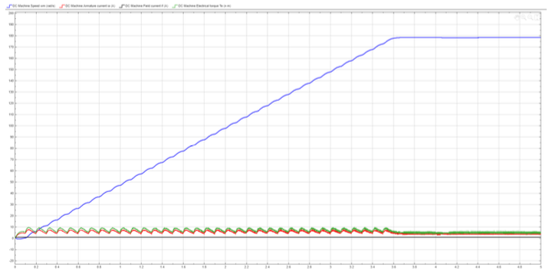
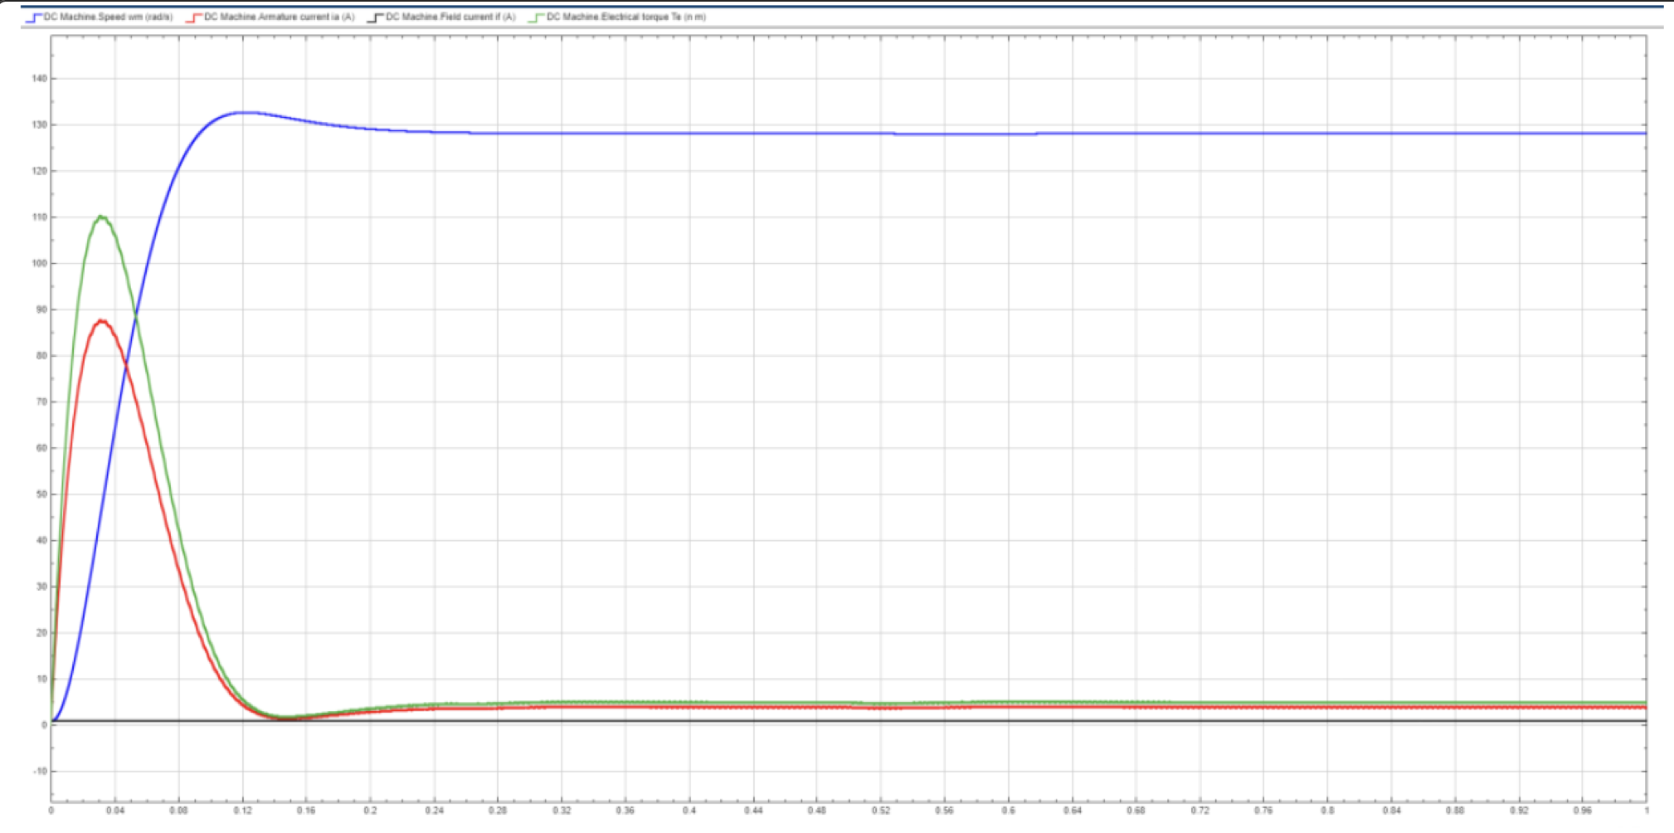
Simulation Results (Inrush Mitigation):
Risk Analysis (Hard Start):
  Simulation showed 120 A inrush current without soft start.
  Verdict: Immediate failure of diode and IGBT.
Solution (Soft Start):
  With Ramp Logic, peak current is limited to ~9 A.
  Result: Safe operation within the SOA (Safe Operating Area) of components.

Slide 9
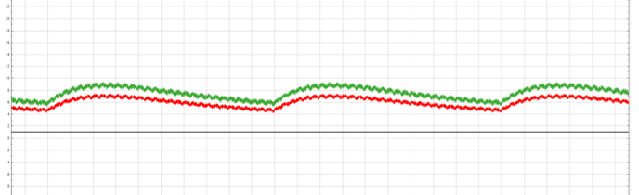
Performance Verification:
Output Stability:
  Target: 180 V Output.
  Operating Duty Cycle: D = 70% (Simulation) vs 58% (Theoretical).
  Reason for difference: Real-world voltage drops (V_IGBT = 2V, Vdiode = 1.5V) included in High-Fidelity model
Ripple Check:
  Switching Frequency: 20 kHz.
  Ripple Current: < 0.5 A
  Conclusion: Motor inductance (24.5 mH) is sufficient; no external inductor needed.

Slide 10
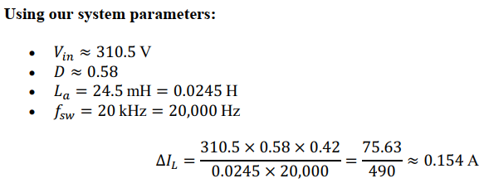

ANALYTICAL CALCULATIONS
Rectifier Output Voltage:
𝑉𝑑𝑐 ≈ 1.35 × 𝑉𝐿𝐿 = 1.35 × 230 V ≈ 310.5 V

Slide 11
A discrepancy was observed between the theoretical duty cycle (𝐷𝑖𝑑𝑒𝑎𝑙 ≈ 0.58) and the
simulation value (𝐷𝑠𝑖𝑚 ≈ 0.7) required to achieve the 180 V output. This is an expected
outcome of the High-Fidelity modeling and is attributed to the following real-world factors:
1. Semiconductor Voltage Drops
2. DC Link Voltage Sag
To compensate for these cumulative losses and the DC link sag, the Duty Cycle must be
increased from the theoretical 58% to approximately 70% (𝐷 ≈ 0.7)

Slide 12



THERMAL CALCULATIONS
Conduction Losses: The general formula for conduction loss is approximated as:
For the IGBT (Assuming 𝑉𝐶𝐸(𝑠𝑎𝑡) ≈ 2.0 𝑉at 20 A and Duty Cycle 𝐷 ≈ 0.5):
For the Diode (Assuming 𝑉𝑓 ≈ 1.5 𝑉):
Total Conduction Loss:

Slide 13

THERMAL CALCULATIONS
Switching Losses (Frequency Dependent)
1. IGBT Switching Loss (IXGH24N60C4D1)
Using the datasheet values for Turn-On (Eon) and Turn-Off (Eoff) energy at the rated test
conditions (360 V, 24 A), we scaled them to our operating point (310 V, 20 A).
Scaling Factor (K):
Total Switching Energy per Cycle:
Power Calculation:
2. Diode Reverse Recovery Loss (MUR1560G)
Diode Loss Equation:
Total Switching Loss

Slide 14
Additional System Losses
While the IGBT and Diode are the primary concerns for the main heatsink, other components
also contribute to the system’s thermal load:
- Input Rectifier (SQL3510): Approximately 15 W conduction loss.
- DC Link Capacitor (470 µF, ESR ≈ 0.2 Ω): Approximately 5 W dissipation.

Slide 15


Junction Temperature Verification
To validate the cooling system design, we calculate the expected Junction Temperature (Tj) of
the components under full load, assuming an Ambient Temperature (Ta) of 25°C and an
Active Fan Cooling system with a thermal resistance of RθSA = 1.0°C/W.
1. Heatsink Temperature Rise
Heatsink Temperature:
2. IGBT Junction Temperature

Slide 16

Junction Temperature Verification
3. Diode Junction Temperature
Conclusion
The thermal analysis confirms that dissipating the total system heat (~66.5 W) requires active
cooling. With the selected Aluminum Heatsink + Fan combination, the component junction
temperatures stabilize at approximately 122°C. This provides a safety margin of roughly 28°C
below the absolute maximum rating (150°C)

